Slide 1
BD Veritor Plus Analyzer
Rapid Antigen Testing for COVID-19
Toronto Regional IPAC Team

Slide 2
Objectives
Purpose and eligibility of rapid antigen screening
Frequency and results of rapid antigen screening
How to order and store the BD Veritor COVID-19 Rapid Test Supplies
Steps to set up a Rapid Test Area
How to use the BD Veritor Plus Analyzer
Test preparation, sample collection, test procedure, results interpretation, and quality control
How to report and document results
Limitations of BD Veritor rapid testing
This presentation was adapted for Safehaven using BD Veritor Education

Slide 3
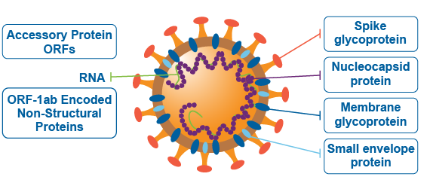
What the test is detecting
In vitro diagnostic rapid test for qualitative detection of SARS-CoV-2 antigen (Ag)
Detects nucleocapsid protein inside the SARS-CoV-2 virus

Slide 4
Purpose
To screen for potentially contagious individuals within 15 minutes
Should only be used on individuals who are asymptomatic
Should only be used to enhance screening processes already in place
Should NOT be used to diagnosis COVID-19 infection
Test in preliminary only
Individuals who are symptomatic require PCR testing from a healthcare provider, an assessment centre, or participating community lab.

Slide 5
Eligibility
Asymptomatic individuals who have passed entry screening
Staff, visitors, volunteers, students, contractors, agency staff, AND clients
Can only be used in areas which are not deemed in outbreak
Individuals who have previously been infected with and recovered from COVID-19 should NOT undergo repeat testing/antigen screening – these individuals get an exemption from routine rapid testing

Slide 6
Frequency
Monthly testing of all Safehaven clients
Used as surveillance to support external partners on their staff and clients are subject to testing on the day we are requested on site.

Slide 7
Results
A positive result on a rapid antigen test is considered a “preliminary positive”
Every preliminary positive must be followed up with a confirmatory PCR test.
Public health unit must be notified.
Individual must be sent home to self-isolate and instructed to seek confirmatory testing

Slide 8
Results
A negative result on a rapid antigen test is only applicable if the individual who has been tested is asymptomatic with no known exposures to COVID-19
Individuals must be counselled that the result is negative and a false negative is possible.
Individuals should be instructed to continue following public health guidelines and infection prevention and control measures.
Notes:
Performance is 84% sensitive and 100% specific
sensitivity is the ability of a test to correctly identify those with the disease (true positive rate), whereas test specificity is the ability of the test to correctly identify those without the disease (true negative rate)

Slide 9
Ordering
TBD – Will be online portal through MCCSS
Instructions to come from Ministry
Notes:
Rohan (rohan.ravindranath@ontariohealth.ca)

Slide 10
Storage
30 tests come with each kit
Stored between 2-30ºC – DO NOT FREEZE!
12 month shelf life
Testing time: 15 minutes – no longer than 16 minutes
In winter months kits may be shipped with heat packs.

Slide 11
BD Veritor Kit Contents
30 test devices
30 pre-filled reagent tubes
30 sterilized nasopharyngeal (NP) swabs for specimen collection
1 Positive control swab
1 Negative control swab
1 tube rack
1 Quick reference guide
1 Instructions for use
Nasal sample quick reference instructions

Slide 12
Who can perform the test?
Regulated and unregulated health professionals can conduct testing
A physician, nurse practitioner, registered nurse, registered practical nurse, dentist, pharmacist, paramedic or community paramedicine practitioner; Audiology and Speech-Language Pathology; Chiropody and Podiatry; Chiropractic; Dental Hygiene; Dental Technology; Dentistry; Denturism; Dietetics; Homeopathy; Kinesiology; Massage Therapy; Medical Laboratory Technology; Medical Radiation Technology; Medicine; Midwifery; Naturopathy; Occupational Therapy; Opticianry; Optometry; Pharmacy; Physiotherapy; Psychology; Psychotherapy; Respiratory Therapy; Traditional Chinese Medicine and Acupuncture
Personal support workers, Physician assistants, Physiotherapy assistants, Speech language therapists, Osteopaths, etc.

Slide 13
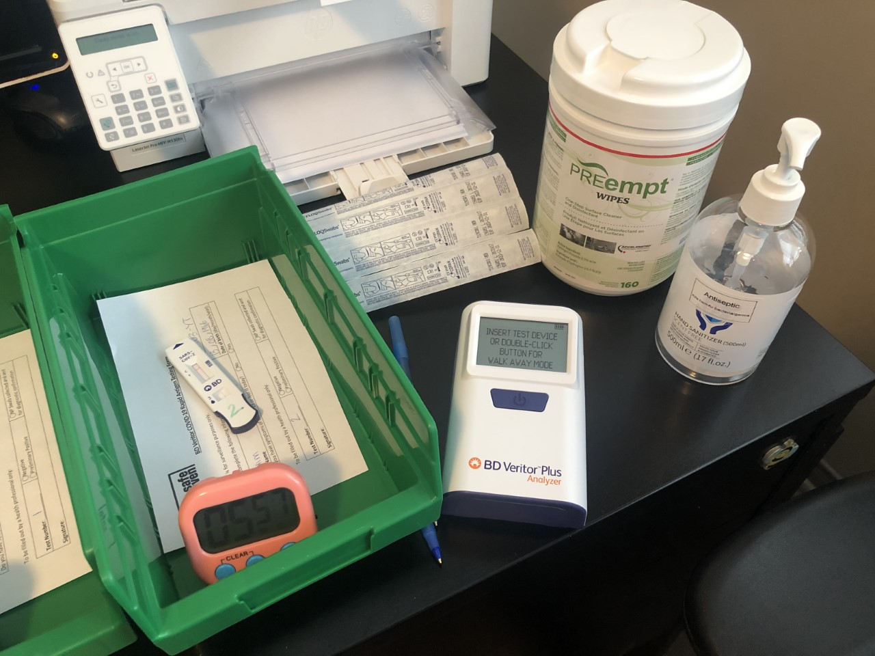
Setting up for Rapid Testing

Slide 14
Conducting Quality Control Before Testing
Quality control swabs should be tested by staff who will be operating the testing station.​
Quality control swabs should be tested:​
with each new shipment of kit​
with any new kit lot number​
by all newly trained operators before they begin testing individuals​
for sites using >1 box of tests/day, perform quality control swabs at the beginning of the day before testing begins​
for sites performing less than <1 box of tests/day, perform quality control swabs each time a new kit box is opened or at least weekly, whichever is more frequent​
It is important to time the control test for the full 15 minutes. ​

Slide 15
Test Preparation
Prepare kits in advance
Pre-filled extraction reagent tube
Test cartridge
Swab
Timer
Bin
Results certificate
Pre-label test tubes and cartridges with participant information (i.e.. Name or initials and DOB)
Two labels are ideal. One for extraction tube, one for test cartridge/device
Record the name of person being tested and store the record in a safe, secure location (P drive)

Slide 16
Detailed steps
Read instructions of the rapid test kit
Ensure full PPE is worn
Collect all the supplies for running the test
Allow all components to come to room temperature (15-30ºC) prior to use
Check expiry date on the back of the test device/cartridge and assure the pouch has not been damaged or tampered with.
Remove test device from the pouch just before testing
Place test device on a flat surface and write or affix label with 2 identifiers

Slide 17
Deep Nasal Sample Collection
Notes:
Collect using same technique for both nostrils.
Insert swab into the nare 2.5cm or until resistance is felt, whichever is first

Slide 18
Administering the Test
Notes:
After setup:
ANALYZE NOW MODE
Step 1: Collect patient sample
Step 2: Remove cap of pre-filled extraction tube and insert swab into tube
Step 3: Mix sample for 15 seconds with reagent, then remove swab, pushing into the side of the extraction tube, at least 5 times
Step 4: Squeeze the swab against the extraction tube wall with your fingers
Step 5: Close dispensing cap and discard swab in biohazard waste bin
Step 6: Dispense 3 drops of sample fluid into sample well of test device
Step 7: Start a timer for 15 minutes to read the result.
Step 8: After 15 minutes insert test device into analyzer
Step 9: read and certify results
Step 11: Convey results in a confidential manner
Step 12: Dispose of used device in a biohazard container
Step 13: Remove and dispose of any labels from testing table
Step 14: Check that all results have been recorded on results tracker and save and store the file securely.
Step 15: Perform PCR test if required.
Step 16: report # of performed tests and # of positive tests to Claudia.

Slide 19
Batch testing workflow
Notes:
Allows up to 24 tests to be analyzed in 1 hour
Dedicated swab person and dedicated operator is required
Timers are used to monitor incubation time

Slide 20
Interpreting the results

Slide 21
Communicating Preliminary Positive Results
Positive results must be communicated in a confidential manner.
Staff must take steps to maintain confidentiality of the results.
Leadership must be notified of a preliminary positive result.
Staff must obtain a PCR test at a rapid assessment center on same day.
Staff must be sent home to self-isolate and await instructions for Public Health.

Slide 22
Results
Positive Results
Rapid antigen testing is considered preliminary. Each positive rapid antigen test must be followed up with a confirmatory PCR laboratory test.
Negative Results
Is only applicable if the individual being tested has no symptoms and no known exposures to COVID-19
Individuals should be counselled that the result is negative, and a false negative is possible.
Individuals should be directed to continue to follow infection prevention and control measures.

Slide 23
Noteworthy
Testing station should be cleaned and sectioned off prior to beginning testing
DO NOT move the test device until the test is complete
Clean up any spillage with a disinfectant wipe
Change gloves after handling each extraction tube
Frequent squeezing of the extraction tube can cause strain (sore fingers), take turns with other staff to reduce strain if possible.

Slide 24
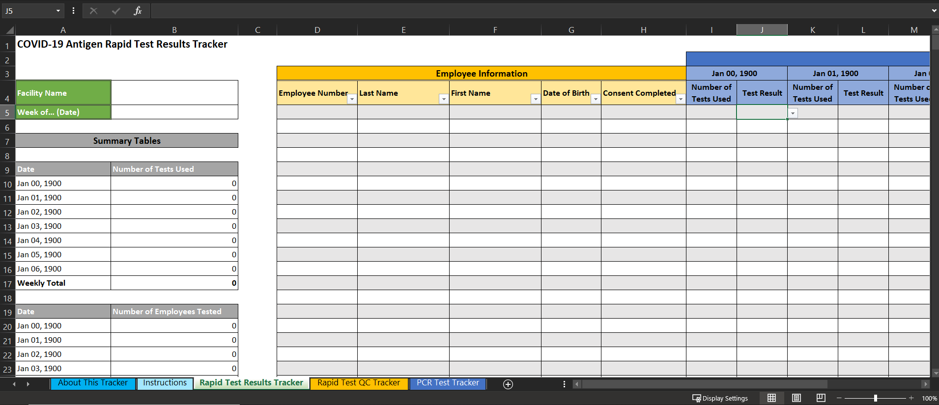
Documentation
Notes:
Documentation can be found in P Drive under Mobile Team folder in the TDAS-IPAC folder
We gather and report aggregate data to the ministry.
Number of rapid tests done, number of positive test, PCR correlation data

Slide 25
Remember
Prepare all test components before specimen collection
Always wear PPE including gloves when handling specimens
Ensure the correct amount of buffer is added to the extraction tube
Test devices are single use only
Treat all specimens as potentially infectious samples
Discard all items into appropriate biohazard containers
Do not mix components of the test kits

Slide 26
Lastly…
Rapid antigen testing is used for screening purposes only and should NOT be used for diagnosis of acute COVID-19 infection
Testing does not prevent someone from getting COVID-19
Rapid antigen testing can be thought of as an additional screening tool
Rapid antigen screening does not replace public health measures such as symptom screening, physical distancing, masking and hand hygiene

Slide 27
Thanks for listening!
Questions?
Email us at:
Ipac-torontoregion@safehaven.to

