Slide 1
CORONAVIRUS (COVID-19)
Safety at home and in the Community

Slide 2
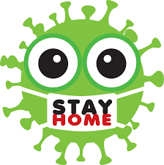
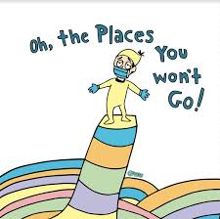
Many people have been staying at home to avoid getting sick
from the coronavirus or spreading germs to others.
This means many places in the community were closed and there were strict rules I had to follow at home.

Slide 3
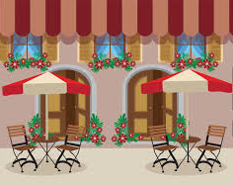
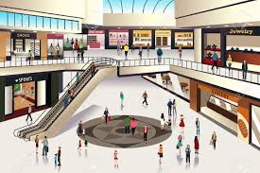
Over the past several months, a lot of work has gone
into making the community safe.
Places in the community are starting to open
and people are spending more time outside of their homes.
.

Slide 4
This means I will be able to do more activities that I enjoy, such as:
Doing outdoor activities
Going to places in the community for a short stay
(coffee shop, mall, hair salon, etc.)
Seeing my family members and friends for visits in my backyard or an outdoor space

Slide 5
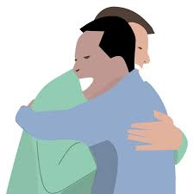
When I see my friends or family members for visits, I can expect:
Brief physical contact. This means I can hug someone for a short period of time, if I choose to
Physical distancing (2 meters/6 feet) - before and after the brief physical contact
Visitors wearing eye protection and masks
That I will be asked to wear a mask
My staff or supervisor present for the visit

Slide 6
As I begin to do more things and see more people,
it is important that I am as safe as possible to avoid becoming sick or spreading germs to others.

Slide 7
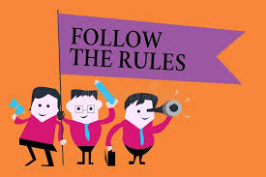
When I go out or visit with my family and friends, I need to follow some rules to make sure we are all safe.
Every place has different rules and I will need to listen to my staff/family or read the signs to understand what I am supposed to do.

Slide 8
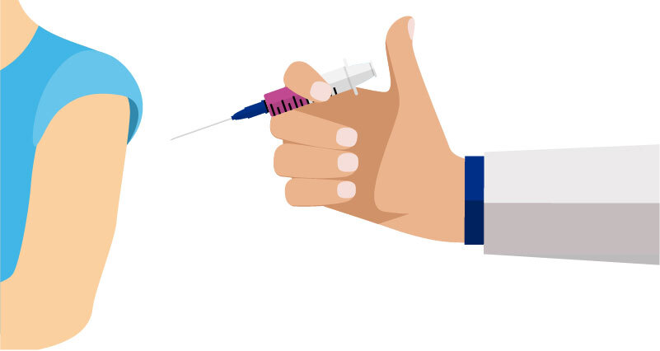
I can be safe by:
Getting vaccinated
Vaccines are safe and the best way to protect me and the people around me from getting very sick from COVID – 19
When it is my turn to get the first and second dose of the COVID – 19 vaccine, I can go ahead and do so
My staff or family can help me with this.
If I have any questions about the vaccine I can talk to staff, a family member
or my doctor.

Slide 9
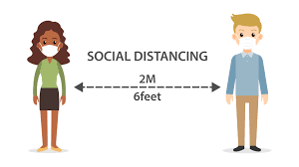
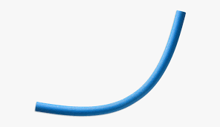
Social distancing.
This means keeping 2 meters/6 feet distance from others
OR the length of 1 pool noodle apart.
Pool Noodle = 6 feet in length

Slide 10
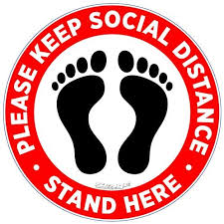
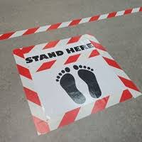
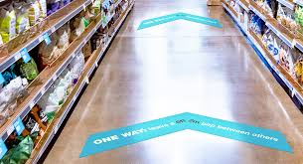
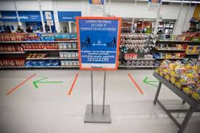
This also means following the signs that places are using to show people where to stand or what direction to walk in.
Signs on the ground tell me where to stand to keep distance from others.
Arrows or lines on the floor tell me what direction to walk in to keep distance from others.

Slide 11
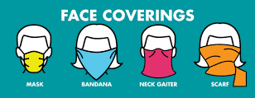
Wearing a mask or face covering that covers
my nose and mouth.
This is especially important when it is difficult to physical distance from others, such as on transit, in an elevator or when shopping.

Slide 12
Staying away from crowds and other people by:
Moving to the other side of the street when others are on the
sidewalk
Choosing to go somewhere else if there is a line-up
Waiting to go into a room until others have left
Greeting others from a distance with a wave or nod

Slide 13
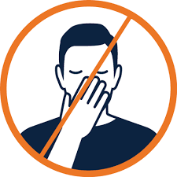
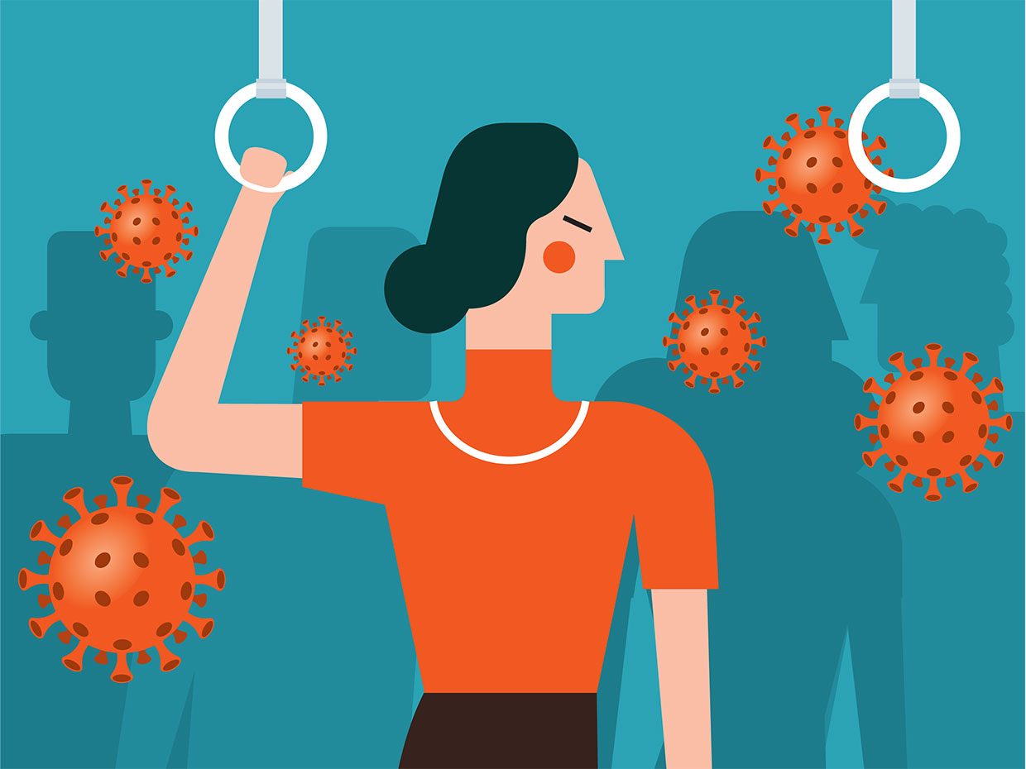
Avoiding touching my face with unwashed hands
or touching public surfaces.

Slide 14
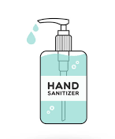
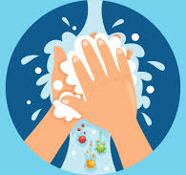
Cleaning my hands often using soap and water or hand-sanitizer
(if soap and water is not available).

Slide 15
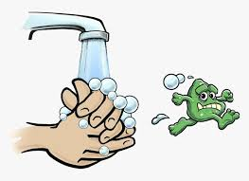
I should wash my hands when:
I come in from outside
After I have touched a surface
or item from outside
Before I touch my face
Before I eat

Slide 16
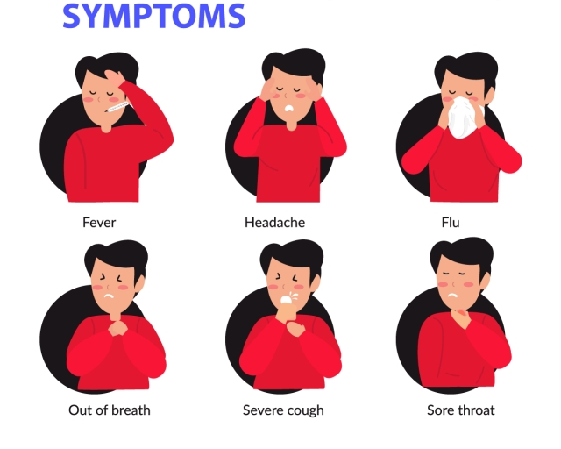
Staying home if I am feeling sick.

Slide 17
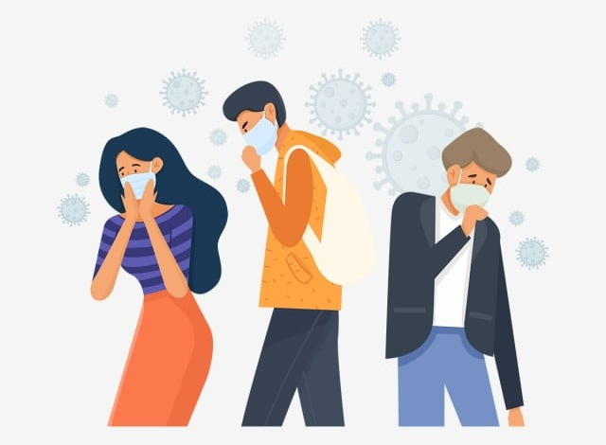
While more people are vaccinated and places in the community are now open, I know that the coronavirus is still around
and spreads easily.
This is why it is important that I follow these rules to be safe.

Slide 18
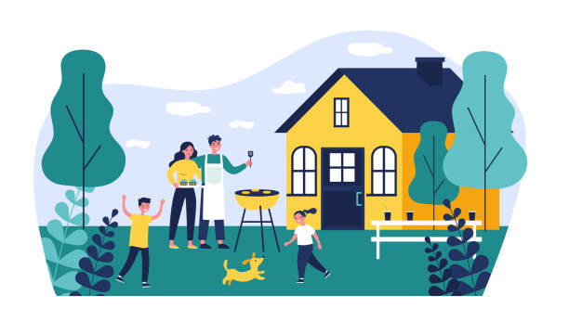
This also means that when I go out in the community
or visit with family/friends, I could still get the coronavirus
or pass on germs to my housemates and staff.
(Even if I am vaccinated and being safe!)

Slide 19
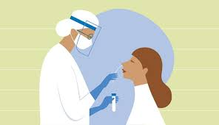
If I am in close contact with someone who has coronavirus
OR if I visit a place in the community where there are coronavirus cases, I will need to get tested.
.

Slide 20
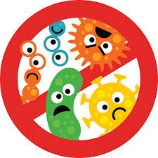
I may also have to self-isolate in a place away from my housemates, family and the community for a period of time - to keep everyone safe.

Slide 21
I also know that things can change very quickly. This means:
Places in the community that are open now could become closed again
People going out in the community now may be asked to stay at home again (to keep everyone safe)
Visits with my family and friends may change or stop

Slide 22
Learning that about these new changes at home and in the community, might make me feel different emotions.
It is okay to feel this way.

Slide 23
I have people in my life who are here to support me.
If I have questions or need support I can talk to them.

