Slide 1
Provincial Network COVID-19 Vaccine Work Group
Hosted by the Sector Pandemic Planning Initiative (SPPI)
Notes:
12:01 start

Slide 2
SPPI: Sector Pandemic Planning Initiative
Established in March 2020, by the Toronto Developmental Service Alliance and Service Providers Committee, to enable collaborations across Toronto agencies in responding to the Pandemic.
Chaired by Ursula Rehdner, President & CEO of Aptus Treatment Centre for Complex Disabilities; Don Walker, Executive Director of Mary Centre of the Archdiocese of Toronto. Supported by Malcom Bernstein, Mia Tremblay and Georgie Vincent at Community Living Toronto.
SPPI is comprised of 40 volunteers across 19 agencies who have been working very hard to produce and distribute guidance documents on a range of topics related to the Pandemic.
Ongoing webinar series focused on resilience, reopening, and ongoing adaption to the Pandemic – NEXT SESSION ON JAN 28 AT NOON
Notes:
INCREASINGLY THESE PAPERS HAVE BEEN DISTRIBUTED ACROSS THE PROVINCIAL NETWORK AND MADE AVAILBLE ON THE REAL EXCHANGE VIRTUAL SITE HOSTED BY COMMUNITY LIVING ESSEX.
THE REAL XCHANGE IS A LIBRARY OF RESOURCES HAS BEEN COMPILED FROM DS SECTOR AGENCIES BY THE PROVINCIAL NETWORK ON DEVELOPMENTAL SERVICES TO ASSIST YOU IN RESPONDING TO THE COVID-19 PANDEMIC THROUGH INFORMATION SHARING AND KNOWLEDGE TRANSFER.
THIS WEBINAR SERIES IS A TESTAMENT TO THAT WORK ETHIC AND COLLABORATIVE SPIRIT.
IN PRODUCING THIS SERIES, I WOULD LIKE TO THANK GEORGIE VINCENT, MIA TREMBLAY AND YOU JAMES OF COMMUNITY LIVING TORONTO AND ALSO OF THE SPPI PROJECT MANAGEMENT OFFICE; AND JEANETTE MACLEAN SENIOR CONSULTANT, OCCUPATIONAL HEALTH AND SAFETY, HEATHER DAWSON SENIOR MANAGER, QUALITY ASSURANCE FOR THIS IPAC ASSESSING PRACTICES THEY ARE GOING TO SHARE WITH ALL OF US TODAY.

Slide 3
Who’s who?
Provincial Network
Not a mandated provincial organization
Volunteer group to inform and engage
Does not replace decision-making authority
Ensure consistent flow of information
Open dialogue with the Ministry
We are not the SPPI
Notes:
12:04

Slide 4
PLANNING INITIATIVE WORKGROUPS
AGENDA
Welcome
PN Vaccine work group – 4 workgroups
Priority and Advocacy
Education, Consent & Promotion
Distribution
Human Resources
Presentations
Hicks Morley – Charles Hofley & Siobhan M. O’Brien
Pooran Law – Consent
Dr. Isaac Bogoch
Qs & As – Lorrie Heffernan, Moderator
Notes:
12:05 We will share some coordinated work and out puts and you will need to fill in the gaps.

Slide 5
Mandate – Advocacy & Priority
Members:
Lorrie Heffernan, Chris Beasley, Eugene Versteeg (M), Yona Lunsky, Marwah Younis Damani, Gina St. Amour
Focus:
Prioritization
Utilizing Research to support Decision Making
Ethical Framework
Advocacy
Connecting with Relevant Ontario Ministers and MPPs
Ministry of Health and Emergency Operations Centre
Public Health – Ontario Health Teams
Output:
Letters to key Ministers
Letter templates for Agency leaders and peaking notes toward advocacy
For staff and those we support
Notes:
12:05

Slide 6
Mandate – Education, Consent & Promotion
Members:
Laurie Thomas (M), Dean Johnson, Gregory Crunican, Amanda Price, Marwah Younis Damani, Brian Swainson, Barbara Wallace
Focus: Covid-19 Vaccine Education
Output: Prepared a PowerPoint presentation, and a One-page information sheet containing educational material related to vaccines and the vaccination process, (videos, social stories, educational links, easy to read material).
Material and other data shared through RealXchange and ConnectABILITY
Group will research the consent process and the educational support surrounding consents, ongoing promotion of the COVID vaccine to support acceptance and uptake.
Notes:
12:10

Slide 7
Mandate - Vaccine Distribution
Members:
Susan Bisaillon (M), Alastair Lamb and Sandy Stemp
Focus: Covid-19 Distribution
Output: Provide a consolidated snapshot of the current vaccine distribution for Developmental Services (DS) in Ontario building on system strengths and opportunities to enable ethical and timely distribution of the COVID19 vaccine
Completion of survey to understand current vaccine distribution supports and gaps for all Ontario DS agencies
Work with local planning tables to build link to local public health unit
Provide a case study utilizing an ethical framework for agencies to consider when prioritizing clients and staff for vaccination
Distribute resources to assist in the preparation of timely vaccine distribution – consent form and associated education.
Notes:
12:15

Slide 8
Mandate - Human Resources
Members:
Dave Ferguson (M), OASIS LR Comm., Ursula Rehdner, Judy Pryde, Eugene Versteeg
Focus:
Legal Opinion on Mandatory Vaccination
Connection with Unions
DSP survey on Vaccine Interest/Hesitancy
Outputs:
Hicks Morley – Opinion shared across the sector
Presentation from Chuck Hofley (Today)
Monthly meetings with CUPE, OPSEU, SEIU
Yona Lunsky & Natasha Kithulegoda Survey – HCARDD/WCH
Notes:
12:20

Slide 9
COVID-19 Vaccine Update
Charles V. Hofley I Siobhan M. O’Brien
January 14, 2021

Slide 10
Pandemic Planning Initiative
COVID-19 Vaccine
Charles V. Hofley I Ottawa
Siobhan M. O’Brien I Ottawa

Slide 11
COVID-19 VACCINE
Agenda
Background: Vaccine in Ontario
Legal Backdrop: Considerations
Mandatory Vaccines:
NON-UNION
UNION
NEW HIRES
Modified COVID-19 Protocol

Slide 12
VACCINE Background
Siobhan M. O’Brien I Partner, Ottawa

Slide 13
Context
Currently no legislative provisions requiring workers in any sector or industry to receive the COVID-19 vaccination, once available to them
Government not likely to mandate vaccinations
Employer COVID-19 protocols

Slide 14
Legal Backdrop: Considerations
Consent to Medical Treatment
Civil Action: Assault/Battery
Informed Consent
Occupational Health and Safety

Slide 15
Legal Backdrop: Lessons from the Flu Shot
Unionized Context
Balance of Interests approach
privacy
intrusion on employee’s physical person
Re KVP Co. Ltd. (1965), 16 L.A.C. 73.

Slide 16
Mandatory Vaccine:
Existing Employees
Charles V. Hofley I Partner, Ottawa

Slide 17
Mandatory Vaccine: Existing Employees (NON-UNION)
Risks
constructive dismissal
voluntary consent/assault/battery
privacy
Risk Assessment = moderate to low

Slide 18
Mandatory Vaccine: Existing Employees (UNION)
A mandatory COVID-19 vaccine policy for existing employees is likely not defensible in a unionized environment
Requires:
a balancing of safety and employee interests in privacy and bodily integrity

Slide 19
Mandatory Vaccine: New Hires (Union and Non-Union)
KVP reasonableness test does not apply
No risk of constructive dismissal
Risks:
privacy
voluntary consent/assault/battery
Risk Assessment = moderate to low

Slide 20
MODIFIED COVID-19 PROTOCOL
Charles V. Hofley I Partner, Ottawa

Slide 21
Modified COVID-19 Protocol
Protocol encourages vaccination
Balancing: provide alternatives, with consequences
Accommodation for substantiated medical and religious reasons
For Non-Union: Modified COVID-19 protocol can be implemented as risk mitigation strategy

Slide 22
Modified COVID-19 Protocol: Strategy for Increasing Voluntary Vaccination
Communication
Engage Stakeholders
Clinics
Incentives

Slide 23
MODIFIED COVID-19 PROTOCOL
Options for Response to Non-Vaccinated Employees
Siobhan M. O’Brien I Partner, Ottawa

Slide 24
Modified COVID-19 Protocol: Alternatives/Consequences
Human Rights Protected:
Evidence based
Does immunization constitute a BFOR
Accommodation to point of undue hardship

Slide 25
Modified COVID-19 Protocol: Alternatives/Consequences
Non-Human Rights Protected Refusals:
Mandated continued use of Personal Protective Equipment (PPE)/Physical Distancing
Reassignment:
Remote Work
Unpaid Leaves

Slide 26
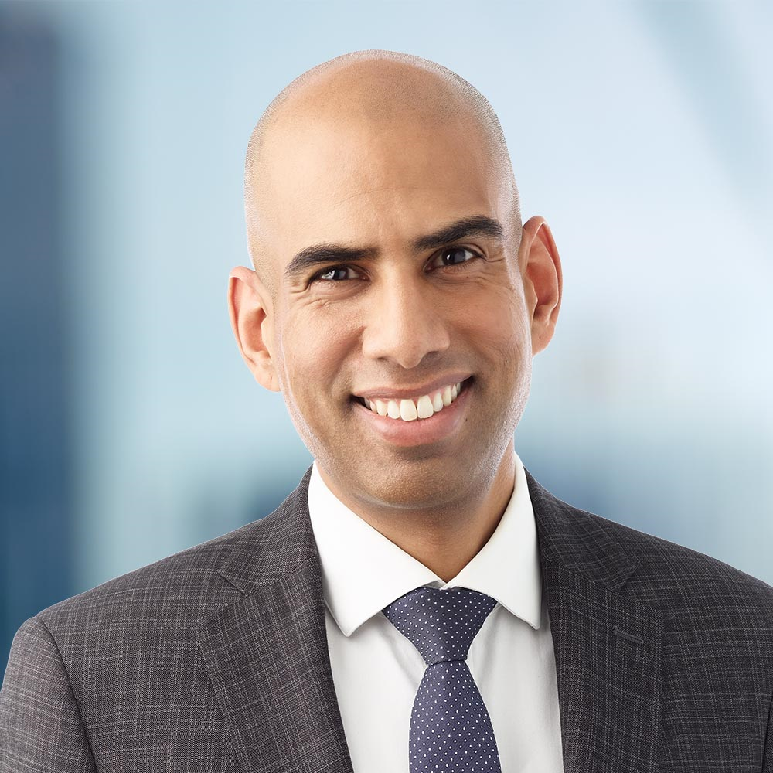
Consent Brendon Pooran – Pooran Law
Partner
LL.B., Osgoode Hall Law School, York University, 2005
B.Comm. (Hons.), School of Business, Queen’s University, 1998
Notes:
12:45

Slide 27
Covid-19 Vaccination plans: Supporting people in service in the DS Sector
January 14, 2020
Brendon Pooran 416-860-7572
bpooran@pooranlaw.com
www.pooranlaw.com
Notes:
I would like to focus my presentation today on covid-19 vaccination plans for people in service, including those currently in service and those who may receive services in the future. As Canada and Ontario continue to move forward with the vaccine roll out, many in the DS sector advocating for our staff and the people we support to be prioritized for receiving the vaccine. Many are turning their minds to planning for the future, including considering mandatory vaccine policies for people in service. In this presentation I would like provide some context for such policies, and will provide an overview of key considerations with respect to mandatory COVID-19 vaccination policies.
A general reminder that information shared during this webinar, is legal information and does not constitute legal advice. I would encourage you to reach out to us or your legal counsel for advice on a mandatory vaccination policy.

Slide 28
The Legal Landscape
Mandate Legislation for Covid-19 Vaccinations: no intention to mandate COVID-19 vaccinations through legislation subject to certain circumstances (i.e. travel)
Health Care Consent Act: requires voluntary, informed consent to medical treatment
QAM: health promotion, medical services and medication obligations
Employment/Labour Law: favours modified vaccination policy
Education Law: mandatory immunization for school-aged children subject to religious, medical exemptions
Child Care Centres: mandatory immunization for children not in school prior to admission to daycare subject to religious, medical exemptions
Long Term Care Homes: mandatory TB screening, recommended vaccinations, obligation to offer influenza annually, and pneumococcus, tetanus, diphtheria vaccines per public health schedules

Slide 29
Key Considerations
Existing/Incoming People in Service
Type of Supports (residential vs. day/community participation)
Age of People Supported
Human Rights and Charter Values
Privacy
Provision of Informed Consent

Slide 30
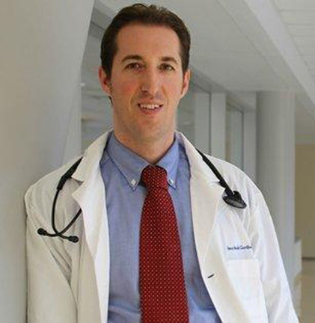
Dr. Issac Bogoch
Infectious Diseases Specialist
Hospital:
University Health Network - Toronto General Hospital
Academic Position:
Clinician Investigator
Notes:
1:00 pm

Slide 31
Closing Remarks with …

Slide 32
Resources
RealXchange
https://realxchange.communitylivingessex.org/
ConnectABILITY
https://connectability.ca/

Slide 33
Connect to Working Group
Mario Longo, Health Services Lead @ Reena
Mlongo@reena.org

