Slide 1


Provincial Network
COVID-19 Vaccine Work Group
Hosted by the Sector Pandemic Planning Initiative (SPPI)
Notes:
12:01 start

Slide 2
Agenda
Welcome – James Janeiro
Introduction to PN Vaccine work group – Bryan Keshen
  Special Guest – Rupert Gordon
  Education, Consent & Promotion – Laurie Thomas
  Rapid Testing – Alastair Lamb
  Priority and Advocacy – Eugene Versteeg
  Distribution – Susan Bisaillion, Sandy Stemp & Tony Caiazzo
Qs & As – Lorrie Heffernan
Notes:
12:05 W

Slide 3
SPPI: Sector Pandemic Planning Initiative
Established in March 2020, by the Toronto Developmental Service Alliance and Service Providers Committee, to enable collaborations across Toronto agencies in responding to the Pandemic.
Chaired by Ursula Rehdner, President & CEO of Aptus Treatment Centre for Complex Disabilities; Don Walker, Executive Director of Mary Centre of the Archdiocese of Toronto. Supported by Malcom Bernstein, Mia Tremblay and Georgie Vincent at Community Living Toronto.
SPPI is comprised of 40 volunteers across 19 agencies who have been working very hard to produce and distribute guidance documents on a range of topics related to the Pandemic.
Ongoing webinar series focused on resilience, reopening, and ongoing adaption to the Pandemic – NEXT SESSION: MAR. 18th @ NOON
Notes:
INCREASINGLY THESE PAPERS HAVE BEEN DISTRIBUTED ACROSS THE PROVINCIAL NETWORK AND MADE AVAILBLE ON THE REAL EXCHANGE VIRTUAL SITE HOSTED BY COMMUNITY LIVING ESSEX.
THE REAL XCHANGE IS A LIBRARY OF RESOURCES HAS BEEN COMPILED FROM DS SECTOR AGENCIES BY THE PROVINCIAL NETWORK ON DEVELOPMENTAL SERVICES TO ASSIST YOU IN RESPONDING TO THE COVID-19 PANDEMIC THROUGH INFORMATION SHARING AND KNOWLEDGE TRANSFER.
THIS WEBINAR SERIES IS A TESTAMENT TO THAT WORK ETHIC AND COLLABORATIVE SPIRIT.
IN PRODUCING THIS SERIES, I WOULD LIKE TO THANK GEORGIE VINCENT, MIA TREMBLAY AND YOU JAMES OF COMMUNITY LIVING TORONTO AND ALSO OF THE SPPI PROJECT MANAGEMENT OFFICE; AND JEANETTE MACLEAN SENIOR CONSULTANT, OCCUPATIONAL HEALTH AND SAFETY, HEATHER DAWSON SENIOR MANAGER, QUALITY ASSURANCE FOR THIS IPAC ASSESSING PRACTICES THEY ARE GOING TO SHARE WITH ALL OF US TODAY.

Slide 4
Provincial Network Vaccine Work Group
Provincial Network
  Not a mandated provincial organization
  Volunteer group to inform and engage
  Does not replace decision-making authority
  Ensure consistent flow of information
  Open dialogue with the Ministry
Notes:
12:04 Bryan

Slide 5

Special Guest- Remarks
Rupert Gordon
Assistant Deputy Minister
Community Services Division
Ministry of Children, Community and Social Services

Slide 6
What are we working on?
Education Working Group
COMMITTEE MEMBERS: Laurie Thomas; Brian Swainson; Dean Johnson; Amanda Price; Gregory Crunican; Marwah Younis Damani
Vaccine hesitancy
Results from the Vaccine Readiness Survey-Next Steps
Increasing vaccine uptake amongst younger adults
Social Media platforms
Vaccine promotion and post-vaccine

Slide 7
Vaccine Hesitancy
Vaccine was primarily tested on Caucasian population.
Thoughts that the Vaccine was Rushed.
MEDICAL MISTRUST IN CULTURAL COMMUNITIES

Slide 8
Vaccination Roadmap for Success
Effects of anti-vaccine movement (Let science speak for itself).
Social media-asset or liability? (Importance of reliable resources).
Understand one another’s perspectives (Wait and see how it’s working versus getting vaccine as soon as you can).
Conspiracy theories (education and information).
Taylor your message to meet staff, client and family concerns.
Personal choice or collective responsibility?

Slide 9
https://www.ama-assn.org/delivering-care/public-health/covid-19-vaccine-hesitancy-10-tips-talking-patients

Slide 10
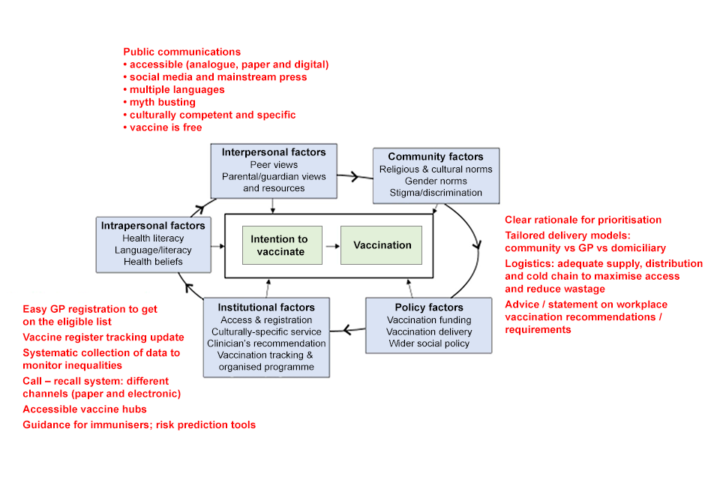
Factors Impacting Vaccination

Slide 11
COVID-19 Rapid Antigen Testing
Expression of interest in Rapid Antigen Testing has been issued by MCCSS
2 types of rapid antigen tests
  BD Veritor (uses a hand-held analyzer unit – about the size of a Sony Walkman – for those who know what they are!)
  Abbot PanBio (no analyzer required)
Benefits of rapid antigen testing
  Results are available within 15 minutes of test being performed
  Mobility – tests can be transported and performed at a variety of locations
  Tests (nasal swabs) can be performed by unregulated staff (DSW etc)

Slide 12
COVID-19 Rapid Antigen Testing
Potential uses of rapid antigen testing
  Staff at beginning of shift
  Supported individuals accessing in-person programs
  Visitors
Results
  Positive rapid antigen tests need to have a confirmatory follow-up PCR test (must be performed by a regulated health professional)
  Rapid Antigen Test false positive rate <1%
Other
  Option to participate in parallel Rapid Antigen/PCR testing research

Slide 13
Priority & Advocacy
Members: Lorrie Heffernan, Chris Beasley, Eugene Versteeg (M), Yona Lunsky, Marwah Younis Damani, Gina St. Amour
Update:
Government Engagement
  Sent letter to Minister of Health (Christine Elliott) and copied Minister of MCCSS (Todd Smith)
  Sent letter to Min MCCSS
  Speaking notes of key messages to org leaders for discussions with MPPs and local Public Health (available)
  Agency Prioritization Survey (from Ottawa)
Next Steps:
Correspondence to Dr. Williams, Ontario’s Chief Medical Officer of Health

Slide 14
Vaccine Distribution
Members:
Susan Bisaillon, Alastair Lamb and Sandy Stemp
Vaccine Readiness
  Consents for Clients and Staff
  Local Clinics – Province announced over 450 clinics – finding this out locally
  Collaboration is Key - Public Health Collaboration local Primary Care Physician / Nurses, Pharmacy
    Completion of Templates and entering clients into COVax database as needed
  Agency Determining – who can travel to clinics / hospitals – staff and clients who need on-site vaccination in care
  Education on Vaccine – Type of Vaccine, potential side effects, addressing vaccine hesitancy issue and addressing cultural barriers
  Ensuring you are working with OPRs, Sils and other vulnerable agencies to ensure everyone is part of the vaccine plan
  To date, we have received information on Regional leads for IPAC and Public Health with the exception of 5 areas! THANKS
Notes:
12:30

Slide 15
Vaccine Distribution
Education
  Critical Success factor for Achieving Vaccine Percentage Rates
  Type of Vaccine - Potential Side Effect,
  Addressing Vaccine Hesitancy Issues and Barriers along with Cultural Nuances
System Issues for Vaccine Distribution
  Regional Differences from Areas of the Province Based on Vaccine Availability
  Connection with PH Units, OHTs and Hospital Hubs are critical to ensuring your staff and clients have a Solid Plan for obtaining the vaccine
Notes:
12:30

Slide 16
York Region Example: Process at a Glance
Clear considerations– number of doses and clients
Worked closely with PH leads as the voice of our sector and propose creative solutions; seeking approval from York Region task force.
Communicated openly and ongoing with agency leads
Prioritized sites with clients who could not safely go to a hospital
Transported clients to nearby sister sites; extra doses offered to staff (15%)
Mapped out sites geographically to stream-line EMS schedule
Ensured documentation was prepared and submitted accordingly
Connected with hospital lead to align with their internal processes

Slide 17

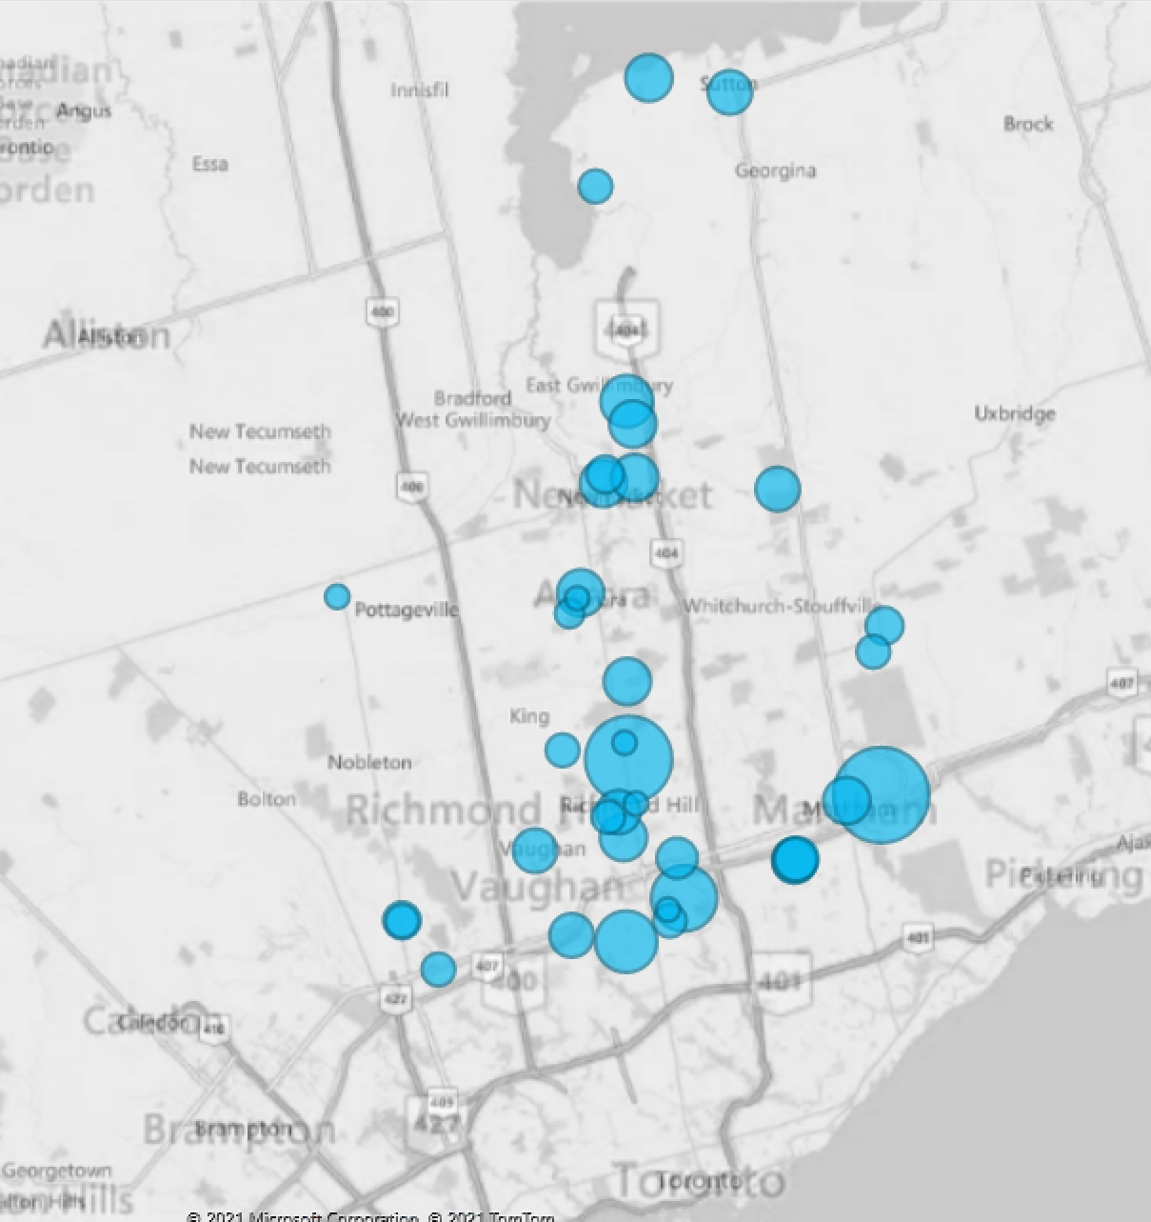
12 Agencies
5 OPRs
360 clients vaccinated on-site
340 clients vaccinated at
the hospital

Slide 18
Lessons Learned
Readiness is key– things will happen fast
Prepare CoVAX template in advance streamlines the process
Identify clients who can and can not go to an off-site clinic
Connect with other agencies and OPRs– high level of communication
Develop regional plan will help everyone involved
Think creatively and collectively
Work with what you have at that moment and be flexible to pivot

Slide 19

Closing Remarks with …

Slide 20
Resources
RealXchange
  https://realxchange.communitylivingessex.org/
ConnectABILITY
  https://connectability.ca/

Slide 21

Connect to Working Group
Mario Longo, Health Services Lead @ Reena
Mlongo@reena.org

Slide 22


