Slide 1
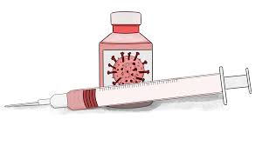
COVID 19 Vaccine:
What’s it all about?

Slide 2
What questions do you have about the vaccines?

Slide 3
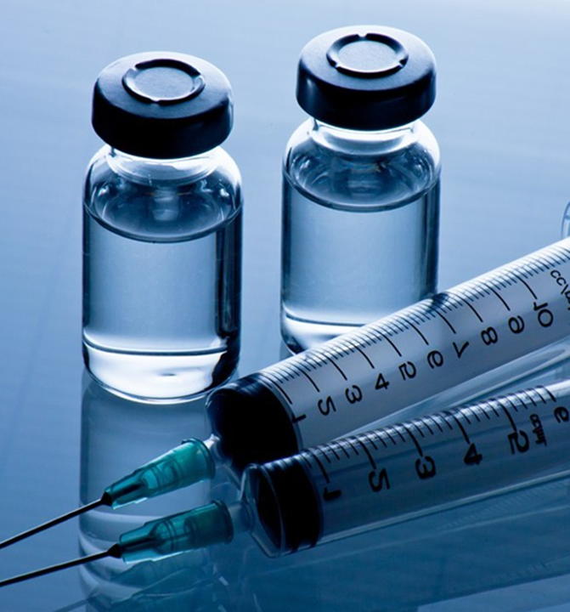
Overview
How do the vaccines work?
How effective are the COVID-19 vaccines?
What are vaccine side effects?
Are the vaccines safe for use in special populations?
How were the vaccines produced so quickly?
Were the vaccines tested in diverse populations?
What is in the vaccines? Can you have allergic reactions?
Do distancing precautions/masks still need to be used after vaccination?
What is the current roll-out and eligibility for the vaccine?

Slide 4
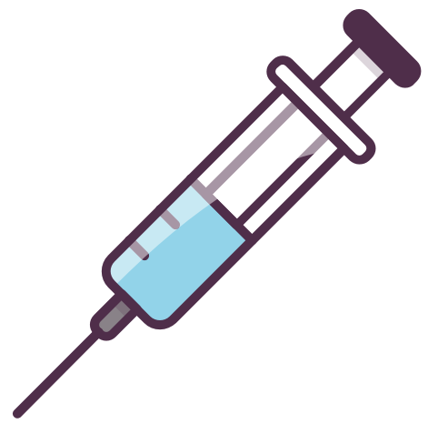
How do the vaccines work?

Slide 5
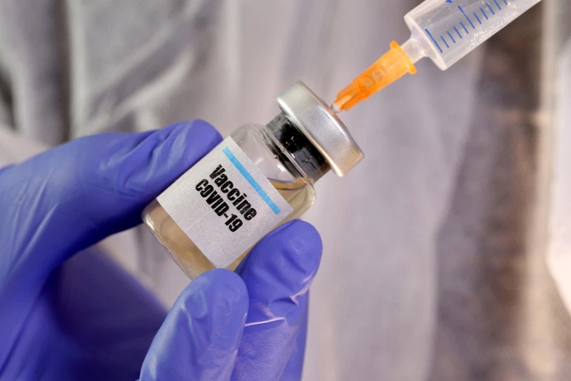
COVID Vaccines
Pfizer-
BioNTech
Astra-
Zeneca
Moderna
Johnson & Johnson

Slide 6
How do COVID vaccines work?
The vaccines teaches your body what the COVID-19 virus looks like so you can fight the virus if you come into contact with it.
Notes:
The vaccine teaches your body what the COVID-19 virus looks like so your body can fight the virus if you come into contact with it.
The spike protein is found on the surface of the coronavirus. It is like an ID badge for the virus.
mRNA is like instruction sheet (like a post-it note) for making the spike protein. Once the instructions (mRNA) are inside our immune cells, the cells use them to make the spike protein. After the protein piece made, the cell breaks down the instructions and gets rid of them.
Then our cells display the spike protein. Our immune systems recognize that the protein doesn’t belong there and begin building an immune response and making antibodies. This is your body’s defense system against infections.
Now that your immune system has learnt to recognize the virus (it recognizes that spike protein, that ID badge), if you come into contact with the real virus, your immune system will attack the virus and prevent it from infecting your cells and making you sick.

Slide 7
Vaccine mRNA does not affect our DNA
DNA
Nucleus
mRNA
Protein
Protein
Notes:
DNA is like our body’s instruction manual
mRNA is like a sheet of instructions that gets copied from the instruction manual
mRNA makes proteins in ribosomes—like a workshop or kitchen where you make things
The mRNA from the virus is used to make the spike protein.
It does not change DNA, which is protected in the nucleus (like the headquarters where your instruction manual is), which is far away from ribosomes (workshop/kitchen)

Slide 8
Can we get COVID-19 from the vaccine?
No!
The COVID vaccines do not contain the COVID virus
They cause your body to make a copy of the spike protein not the virus itself
Possible short-term vaccine side effects may be similar to symptoms of infection but one cannot get COVID-19 from the vaccine

Slide 9
How effective are the COVID vaccines?

Slide 10
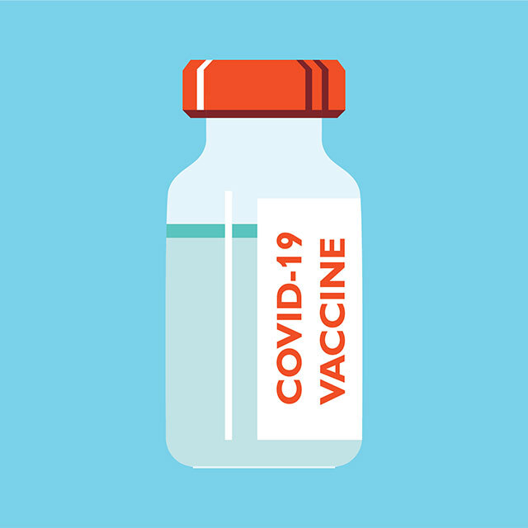
Pfizer-BioNTech and Moderna
Vaccine Clinical Trials (studies)
Pfizer-BioNTech | Moderna
>40,000 participants | >30,000 participants
≥ 16 years | ≥ 18 years
21 days apart | 28 days apart

Slide 11
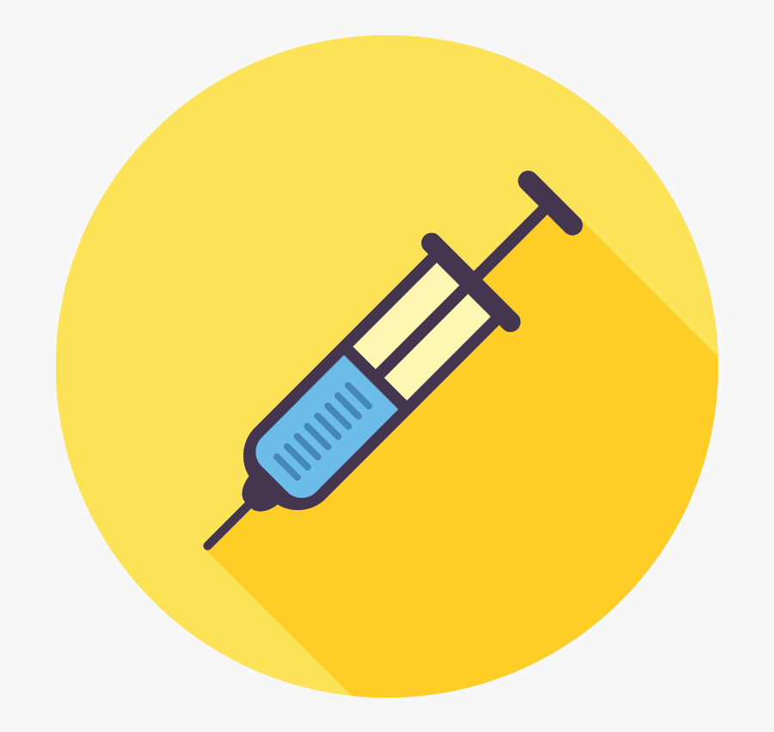
How effective are the mRNA vaccines in protecting against COVID-19 illness?
Pfizer-BioNTech | Moderna
95% (7 days after 2nd dose) | 94.1% (14 days after 2nd dose)
Efficacy consistent across age, gender, race and ethnicity demographics

Slide 12
AstraZeneca and Johnson & Johnson
Vaccine Clinical Trials (studies)
AstraZeneca | Johnson & Johnson
>32,000 participants | >43,000 participants
≥ 18 years | ≥ 18 years
4-12 weeks apart | ONLY 1 INJECTION

Slide 13
How effective are the viral vector vaccines in protecting against COVID-19 illness?
AstraZeneca | Johnson & Johnson
79% (14 days after 2nd dose) | 66% (14 days after single dose)
*Rollout of the AZ vaccine is currently paused in people under age 55 in Canada as they look more into its safety
Notes:
CHECK: Efficacy consistent across age, gender, race and ethnicity demographics

Slide 14
How effective are the COVID vaccines in protecting against HOSPITALIZATION?
Vaccine | Protection from hospitalization
Pfizer-BioNTech | 100%
Moderna | 97%
AstraZeneca | 100%
Johnson & Johnson | 100%

Slide 15
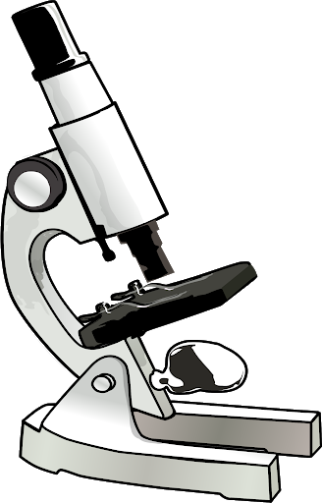
What we are learning
How effective are the vaccines against the new variants?
How long does the vaccine provide immune protection? Will we need booster shots?
Do the vaccines prevent spread of COVID-19?

Slide 16
What are the side effects of the COVID-19 vaccines?

Slide 17
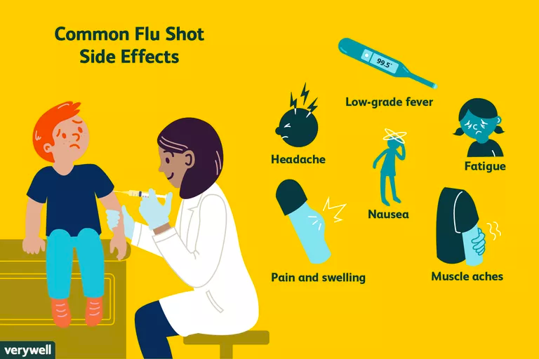
What are common side effects?
Very common ≥10% (more than 1 in 10 doses)
pain at the injection site
headache, feeling tired
muscle or joint pain
fever or chills
swelling or tenderness under the armpit (Moderna)
Common 1%-10% (1 in 100 to 1 in 10 doses)
redness & swelling at the injection site
nausea & vomiting
Uncommon 1% (1 in 100 doses)
enlarged lymph nodes
Very rare
serious allergic reactions such as anaphylaxis
Source: Toronto Public Health
Similar to types of side effects from other vaccines
Generally resolve in 1-3 days
Notes:
anaphylaxis: other vaccines generally 1 per million
JAMA data from USA (published Feb 12-- data from Dec 14-Jan 18): Pfizer: 4.7/million; Moderna: 2.5/million

Slide 18
Do we really know enough about the side effects of the vaccine?
As of March 22, 2021:
458 MILLION DOSES OF VACCINES HAVE BEEN PROVIDED WORLDWIDE
https://ourworldindata.org/covid-vaccinations

Slide 19
Are vaccines safe for people with certain medical conditions?

Slide 20
Special considerations
Immunocompromise (conditions/meds)
Autoimmune disorders
Talk to your health care provider

Slide 21
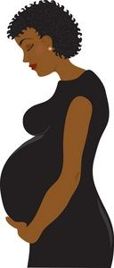
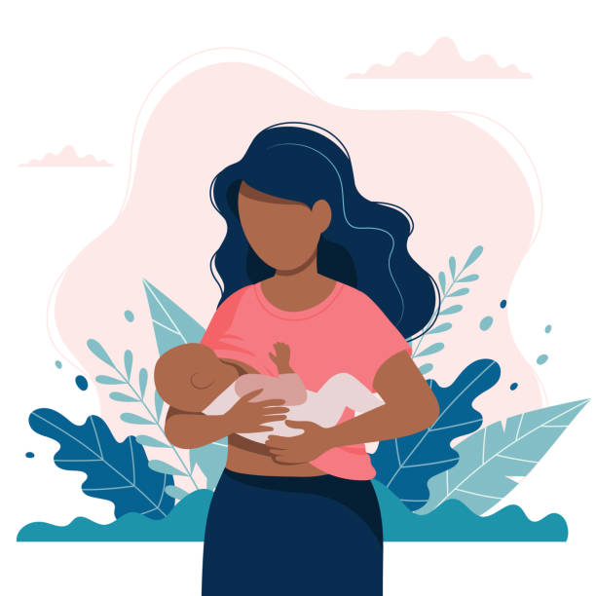
Can I get the vaccine if I am pregnant or breastfeeding?
Recommended by WHO and other expert groups
Based on how vaccines work → unlikely to pose a specific risk
Risks of severe illness from COVID-19 infection during pregnancy
Further studies underway
Talk to your health care provider

Slide 22
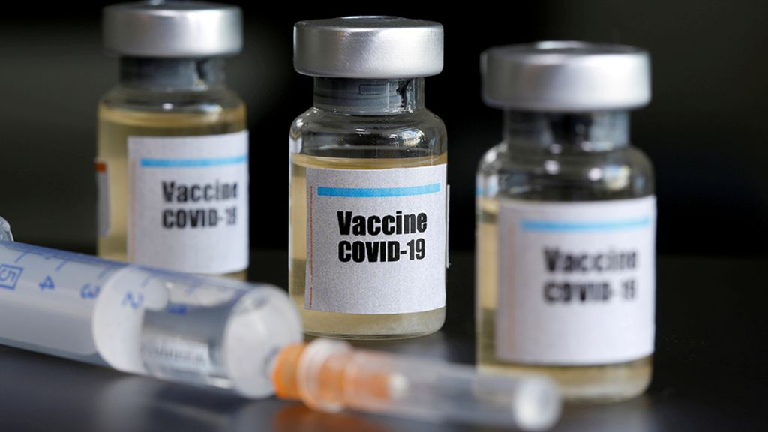
Should I get the vaccine if I already had COVID-19?
Yes!
Even if you had COVID-19 in the past, it is uncertain how long the antibodies (immune protection) will last
Notes:
Experts do not yet know how long someone is protected from getting sick again after recovering from COVID-19

Slide 23
How were the vaccines produced so quickly?

Slide 24
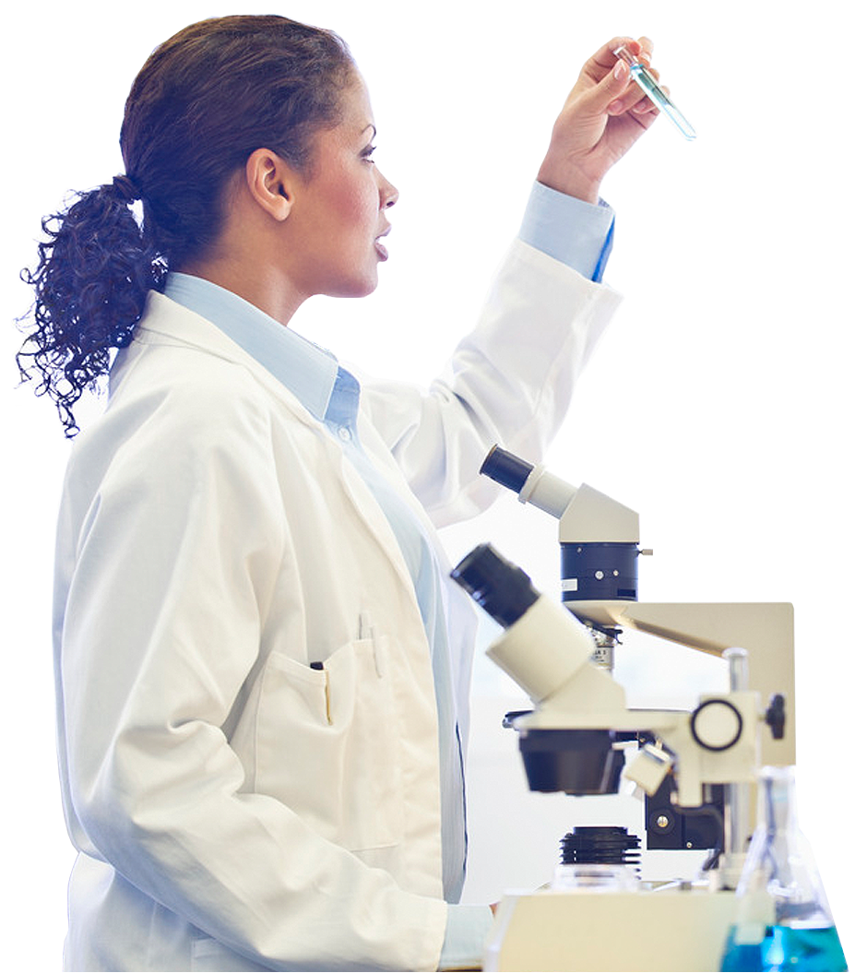
Funding
Existing mRNA technology
Virus genetic sequence
International collaboration
Efficient review processes
NO STEPS WERE SKIPPED
This Photo by Unknown author is licensed under CC BY-NC.

Slide 25
Were the vaccines tested in diverse populations?

Slide 26
Studied in diverse populations
Self-identified racial or ethnic background* | Pfizer-BioNTech Vaccine Study | Moderna Vaccine Study
White | 83% | 79%
Black or African American | 9% | 10%
Asian | 4% | 5%
Indigenous (“American Indian” or “Alaska Native”) | 0.5% | 0.8%
Native Hawaiian or Pacific Islander | 0.2% | 0.2%
Multiracial | 2% | 2%
Hispanic/Latinx | 28% | 21%
The vaccines were equally effective in people of different racial and ethnic backgrounds.
Notes:
Moderna vaccine study was conducted in the USA and the Pfizer-BioNTech vaccine study was conducted in the USA, Argentina, Brazil, Germany, South Africa, and Turkey.

Slide 27
Studied in diverse populations
Self-identified racial or ethnic background* | AstraZeneca Vaccine Study* | Johnson & Johnson Vaccine Study
White | 80% | 62%
Black or African American | 5% | 17%
Asian | 4% | 4%
Indigenous (“American Indian” or “Alaska Native”) | -- | 8%
Native Hawaiian or Pacific Islander | -- | 0.3%
Multiracial | 10% | 45%
Hispanic/Latinx | -- | 45%
Notes:
AstraZeneca studied in: UK, Brazil
The Johnson and Johnson study took place in the USA, Brazil, South Africa as well as five other countries in Latin America (Argentina, Chile, Colombia, Peru and Mexico).

Slide 28
What’s in the COVID-19 vaccines?

Slide 29
What’s in the mRNA vaccines?
Medicinal ingredient: mRNA
Non-medicinal ingredients:
Fats
Salts
Sugar
Water
PFIZER-BIONTECH
Fats: ALC-0315 = ((4-hydroxybutyl)azanediyl)bis(hexane-6,1-diyl)bis(2-hexyldecanoate); ALC-0159 = 2-[(polyethylene glycol)-2000]-N,N-ditetradecylacetamide; 1,2-Distearoyl-sn-glycero-3-phosphocholine; Cholesterol
Salts: (Dibasic sodium phosphate dihydrate; Monobasic potassium phosphate; Potassium chloride; Sodium chloride)
Sugar: sucrose
MODERNA
Fats: Lipid SM-102 PEG2000 DMG (1,2-dimyristoyl-rac-glycerol,methoxy-polyethyleneglycol); 1,2-distearoyl-sn-glycero-3-phosphocholine (DSPC); Cholesterol
Salts: Sodium acetate
Acid stabilizers: Tromethamine; Tromethamine hydrochloride
Sugar: sucrose

Slide 30
What’s in the viral vector vaccines?
Medicinal ingredient: modified adenovirus (cold virus)
Non-medicinal ingredients:
Salts
Acid stabilizers
Emulsifier
+/- Sugar
Water
ASTRAZENECA
Salts: Sodium chloride
Acid stabilizers: L-histidine, L-Histidine hydrochloride monohydrate, magnesium chloride hydrate, disodium edetate dihydrate (EDTA)
Ethanol
Emulsifier: polysorbate 80
Sugar: sucrose
JOHNSON & JOHNSON
Salts: Sodium chloride, sodium hydroxide
Acid stabilizers: citric acid monohydrate, 2-hydroxypropyl-B-cyclodextrin (HBCD), hydrochloric acid, trisodium citrate dihydrate
Ethanol
Emulsifier: polysorbate 80

Slide 31
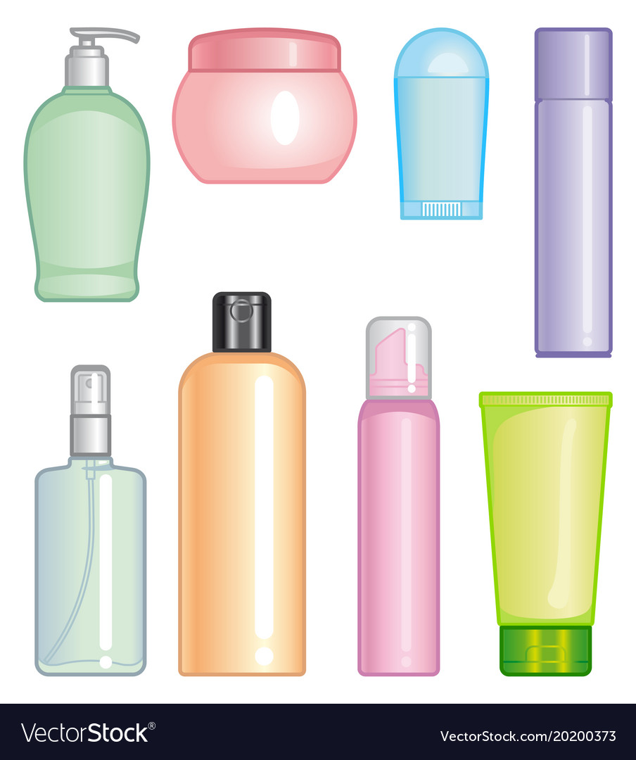
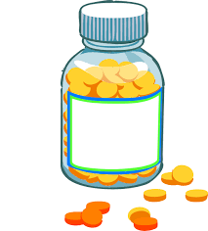
What is polyethylene glycol (PEG)?
Common substance found in:
Laxatives and bowel preparations
Certain cosmetic products
ES Tylenol, Tylenol EZ tabs, Tylenol gel caps, Benadryl 25mg or 50mg pink caplets, Laxaday, Go-lytely, Reactine 5-10mg tablets, Advil liquid gels, Enteric coated ASA 81mg

Slide 32
What is polysorbate 80?
Common substance found in:
Many food products (e.g. ice cream, gum, etc)
Certain cosmetic products
Other vaccines (e.g. flu vaccine)

Slide 33
What is NOT in the vaccines?
Food products
Nuts
Antibiotics
Thimerosal
Formaldehyde
Fetal cells
Microchips

Slide 34
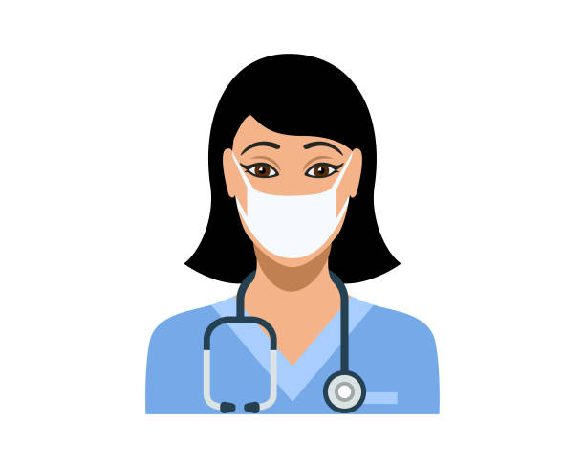
What to do if people have pre-existing allergies?
Medical staff are available at all sites to deal with allergic reactions
If history of severe allergies, wait 30 min after vaccination

Slide 35
Caution with COVID-19 vaccines
Severe allergy to vaccine ingredients (e.g. PEG)
Severe allergy to prior COVID vaccine
Talk to your health care provider

Slide 36
What happens after receiving the vaccine?

Slide 37
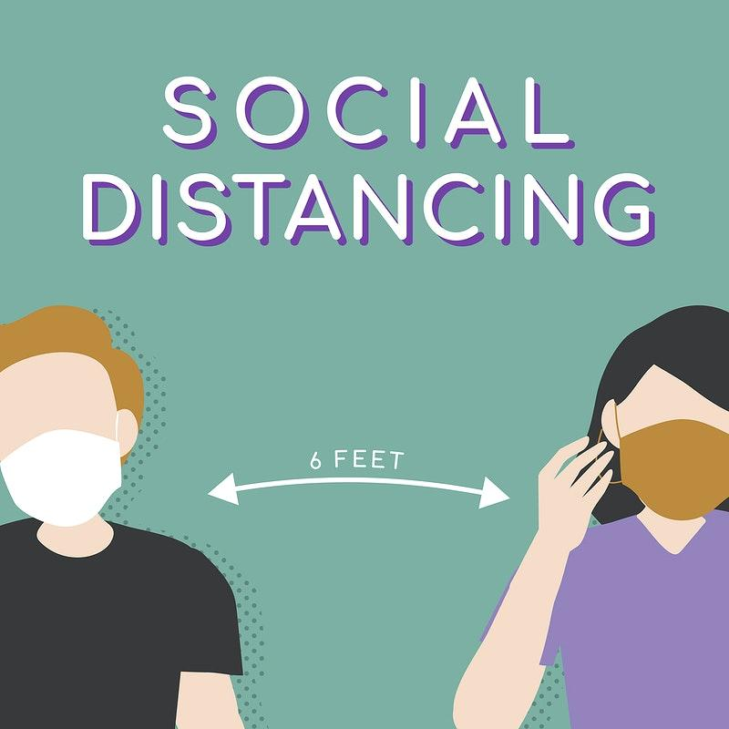
What happens after receiving the vaccination?
Unclear if can still carry virus
Some people will still get symptomatic illness
If fever after vaccine, must still rule out COVID-19 infection

Slide 38
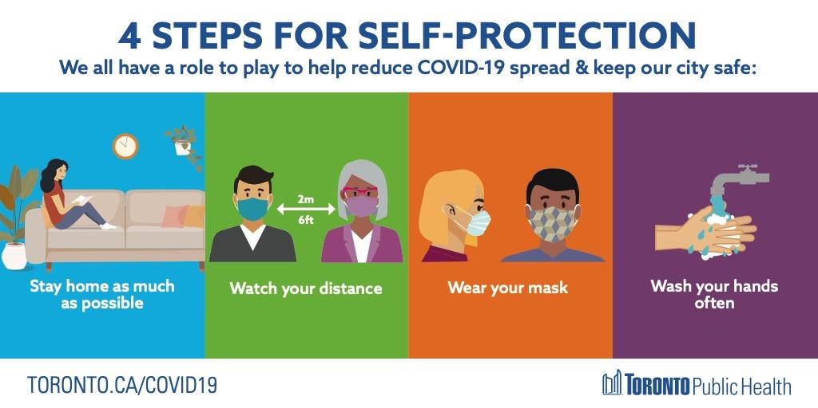

Slide 39
The most recent Phase III trial results from the US identified no safety concerns related to the vaccine.
However, National Advisory Committee on Immunization (NACI) in Canada has recommended pausing the use of the vaccine in individuals under 55 to confirm the vaccine is safe after rare instances of blood clots were observed in Europe.
European countries have since resumed use of the vaccine.
Is the AstraZeneca vaccine safe?
Surveillance systems are in place to look for signs of safety concerns and respond immediately in the case that adverse events are detected.
19 TO ZERO UNITED AGAINST COVID-19 | MAR 2021
Notes:
Updated Mar 29/21
AZ vaccine and blood clots
There is a lower rate of blood clots among those who have had the vaccine compared to the general population.
COVID-19 infection causes blood clots at a much higher rate
The benefits of the vaccine far outweigh the risks as explained by the WHO.

Slide 40
What is the plan for the vaccine roll-out and who is eligible?

Slide 41
Provincial Roll Out: Phase 2 (Apr-July 2021)
Category | Population Size
Seniors (60-79) | 2.5 million
Health conditions Congregate setting | 2.9 million 0.2 million
Hot spots (age & risk) | 0.9 million
Cannot work from home | 2.5 million

Slide 42
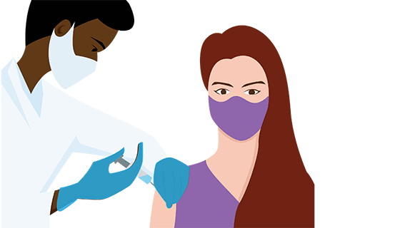
COVID-19 vaccines are free
OHIP card not required
https://www.hopkinsmedicine.org/

Slide 43
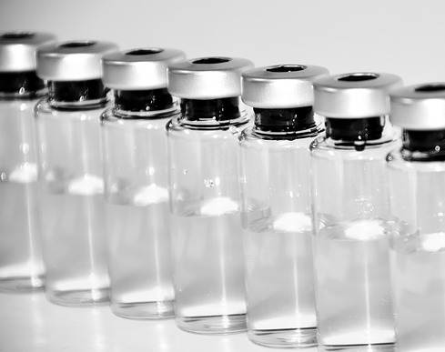
Summary
Vaccines are well studied, safe, effective
Many people are at high risk of COVID exposure in work, transit, housing
Vaccines protect you
Contact us with any questions!

Slide 44
Any questions?
Thank you!
Questions?
Notes:
Time for Q&A

Slide 45
More trusted info on COVID-19 vaccines:
Multilingual handouts:
https://bit.ly/vaccinebulletin
Health Canada:
https://www.canada.ca/en/health-canada/services/drugs-health-products/covid19-industry/drugs-vaccines-treatments/vaccines.html
Toronto Public Health:
https://www.toronto.ca/home/covid-19/covid-19-protect-yourself-others/covid-19-vaccines/covid-19-about-the-vaccines/
Hamilton Public Health:
https://www.hamilton.ca/coronavirus/covid-19-vaccine-frequently-asked-questions

Slide 46
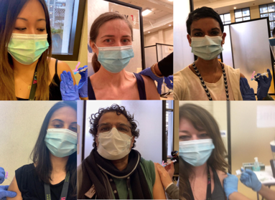
Crossroads Clinic nurses and doctors receiving the COVID-19 vaccine

Slide 47
