Slide 1
How to Manage Crisis Communications

Slide 2
Agenda
Three stages
Planning
When the crisis hits
After the crisis

Slide 3
What is a crisis
A crisis can happen anywhere What defines a crisis varies from organization Crisis vs issues management How you communicate under pressure has some common elements

Slide 4
Planning

Slide 5
Common fears
I don’t know where to start What if I mess this up? I hate conflict I’m uncomfortable with the tough conversations

Slide 6
Crisis communications plan
Communications tools + processes
Media relations policy
Social media guidelines
Messaging per risk
key messages
press release
digital media holding statements
Key audiences and stakeholders
Roles and responsibilities of team members and board
Contact information
team members
media
stakeholders
Lots of checklists!!

Slide 7
Planning
Know your sites, organization and community What are your key risks/hazards?
Site specific
Organization wide

Slide 8
Planning – risk specific
What information do families need to know? Staff? Stakeholders? Ministry? What are your key messages? Who are your spokespeople?
Organization – chair, ED?
Site – supervisor, manager?

Slide 9
Crisis communications plans
Site – Think through scenarios and prewrite your messaging Organization - Create a crisis communications plan Make this a living document Involve multiple individuals and stakeholders

Slide 10
"My father used to say to me, ‘Whenever you get into a jam, whenever you get into a crisis or an emergency...become the calmest person in the room and you'll be able to figure your way out of it.'"
- Rudolph Giuliani,
Former Mayor of New York City

Slide 11
Relationships are key
Relationships developed will be your saving grace Don’t let a crisis be the first time you pick up the phone What relationships do you need to develop or foster?

Slide 12
Practice, practice, practice
Think about your risks or what you may need to communicate under pressure
Smaller group discussions with your team in advance
Organizational exercises
Crisis communications training – walk through the plan with key staff and board members

Slide 13
Planning wins!
Gain confidence Figure out gaps – resources, training, people Identify weak links Know who needs support and who you need to muzzle!

Slide 14
When the crisis hits

Slide 15
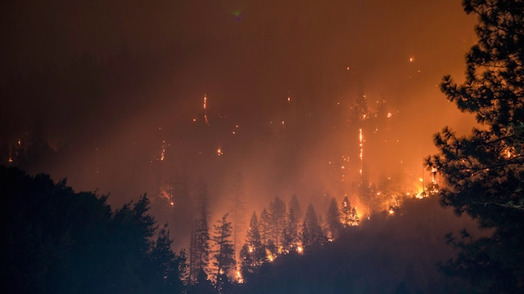
When the crisis hits
Get out early Establish a voice State the obvious and be in control Start with empathy and gratitude…every time Be present!

Slide 16
Gather the team
Bring players together – internally and stakeholders (in-person or Zoom) Limit email cc Get the facts – separating facts from rumours Clarity on lead agency and/or person Massage/manage egos

Slide 17
Clear communications
Identify your key audiences and best communications tools Confirm scope of emergency or issue Don’t overwhelm people with too much information What information is critical now and what can be told later

Slide 18
Communications channels
Families - emails, phone calls, in-person conversations, Zoom meetings
Board - emails, phone calls, in-person conversations, Zoom meetings
Staff – emails, texts, in-person conversations, Zoom meetings
Stakeholders – emails, phone calls, Zoom meetings
Media – press release or media alert, website, social media

Slide 19
Communications channels
Determine frequency of communications and stick to it!

Slide 20
Online presence
Website is the central point for information
Have emergency specific page
Easy to access from home page
Social media
Links to website
Show gratitude and empathy

Slide 21
Role of communications team
Anticipate questions and concerns Write briefing notes, speaking notes and/or Q&A Monitor the media interest Adjust messaging and follow up if needed based on questions asked Update website and social media
Organization wide communications

Slide 22
Internal audiences
Don’t forget to keep staff and volunteers informed Empathy and gratitude Regular updates Share relevant information with them so they aren’t surprised

Slide 23
Accept help
A crisis isn’t the time to do it alone Draw upon established relationships – both professional and personal Ask for help

Slide 24
Crisis wins
Families, stakeholders and media have a reliable source of information New relationships are formed You gain experience and your stock rises You prevent a vacuum from sucking up your organization Great resume piece

Slide 25
After the crisis

Slide 26
Lessons learned
Hold debrief with key players
Create a communications summary – what worked, what didn’t, lessons learned Share this in a debrief with your management team, board, staff, key stakeholders
Doesn’t need to be extensive but important to close the loop

Slide 27
Next steps
Identify training needs – you and the team Review stakeholder communications – what worked, what didn’t Dust off your plan and keep practicing

Slide 28
Self care
Breathe
Check in with each other
Make this someone’s job!!
Don’t do it all yourself
Take time off
Get help if needed. Don’t be afraid to ask!

Slide 29
Thank You!
Cynthia Lockrey
cynthia@lockreycommunications.com
learnpatientadvocacy.com
howtocommunications.com

